Slide 1
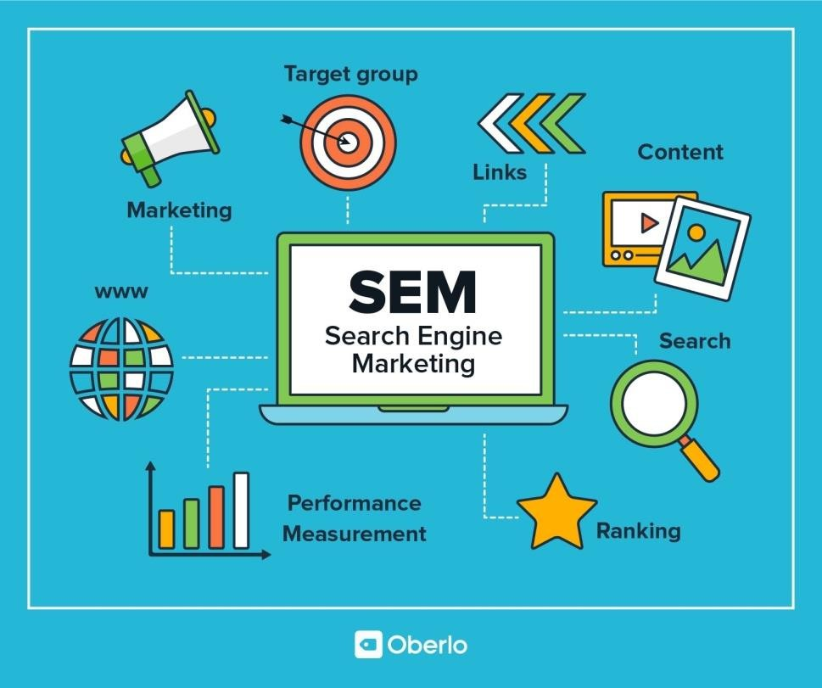
SEM Services in Pakistan
SEM stand for Search Engine Marketing (SEM)
Definition, importance and how it works
Search engine marketing (SEM) is the process of placing ads to help improve the ranking of your brand and content in search engine results. SEM uses a pay-per-click model to help businesses reach their target audience and increase their visibility in search engines.
Today, when you want to learn more about something, you're likely to type your question into a search engine to quickly find the answer. Many consumers around the world use search engines to help them search for content, information, and answers to their questions. Advertisers are also leveraging search engine results pages (SERPs) to help products, brands or websites gain visibility through digital marketing programs known as search engine marketing (SEM) or paid search.
SEM is one of the tools marketers use to grow their business in a highly competitive market. This guide is intended and provides a brief introduction to the basics, techniques, and solutions for SEM.
What is search engine marketing (SEM)?

Slide 2
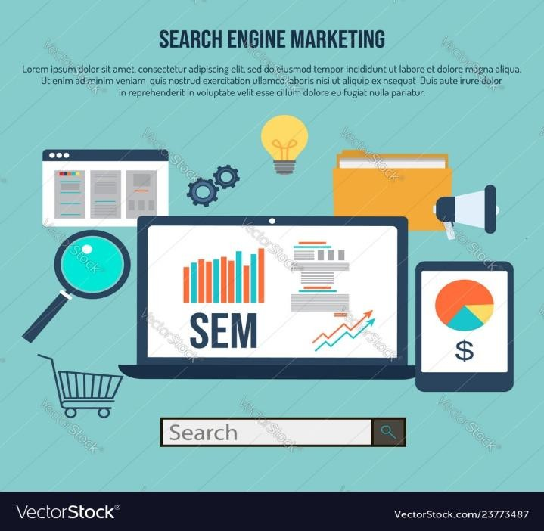
Search engine marketing (also known as SEM or paid search) is a paid digital marketing program that advertisers can use to increase the visibility of their website or product to an audience through SERPs.
Before we get into the tips and tricks about SEM, let’s discuss how it came about. After the birth of the Internet, search engines created opportunities for advertisers to leverage SERPs in their marketing programs. Open Text Corporation created the first pay-per-click (PPC) advertising, which shaped the earliest SEM paradigm. 1 However, this marketing scheme did not receive an official name until 2001. 2 At the time, technologist and journalist Danny Sullivan coined the term in an article he wrote for his search engine marketing publication.
User interaction
The term was coined to indicate that SEM belongs to the field of marketing itself. As more devices enable consumers to browse the internet, post on social media and discover new products, search engines can help guide audiences to content and websites. Over time, SEM has become increasingly popular among advertisers. SEM is now a multi-billion dollar industry. 4 Here’ what you need to know abou SEM. What is the difference between SEO and Search Engine Marketing?
You may have heard of search engine optimization (SEO). This is an important marketing strategy that can help brands attract consumers' attention, increase website traffic and drive business growth.
However, it’s important to understand the difference between SEM and SEO.
The key difference between SEO and SEM is that SEM uses a paid search scheme to display on SERPs, while SEO uses a natural search scheme to display on search results pages. SEM uses paid plans to rank higher on SERPs, improve search visibility, and help drive traffic to a website or specific web pages. An example of these options is setting up and optimizing ads, and setting a budget to pay for ad space.
How does search engine marketing work?

Slide 3
SEM uses paid advertising to ensure that your brand’s goods or services are discoverable by customers on search engine results pages (SERPs). When a user enters a keyword or search term, SEM displays your brand on the results page for that search query. Advertisers pay for impressions, which help direct visitors to your website, landing pages, social media channels or product pages.
Simply put, marketers need to pay or bid for a top SERP ad spot for a certain keyword.
Why is SEM important?
SEM can help brands increase awareness. Ultimately, the higher a brand’s ads appear or rank on search engines, the more likely it is that audiences will see those ads. Appearing at the top of SERPs can help brands drive awareness and purchase intent, and gain customer trust.
Additionally, SEM is an important way for marketers to drive traffic to their website, landing pages, and product pages through SERPs. The ultimate goal of SEM is to increase the visibility of your website, using various techniques and solutions to attract more visitors to your website. In addition, marketers can also use paid search, contextual promotion, and organic search rankings to increase website visibility.
When it comes to paid advertising, SEM can deliver higher click-through rates (CTR) and conversion rates than other passive forms of marketing. Moreover, its PPC model allows businesses to easily tailor their advertising campaigns, allowing brands to focus on specific keywords to help reach relevant audiences.
How does search engine marketing work?
SEM uses paid advertising to ensure that your brand’s goods or services are discoverable by customers on search engine results pages (SERPs). When a user enters a keyword or search term, SEM displays your brand on the results page for that search query. Advertisers pay for impressions, which help direct visitors to your website, landing pages, social media channels or product pages.
Simply put, marketers need to pay or bid for a top SERP ad spot for a certain keyword. Keywords and account structure
As mentioned above, search engine providers often use paid search programs. Therefore, brands can conduct keyword research and create ad campaigns targeting specific keywords related to your industry, products or services. When users search for these keywords, they may see search ads at the top or bottom of the SERP. If a user clicks on the ad, the brand pays for each click on the ad. This method is called pay-per-click advertising.
Promote on Amazon shopping search results pages
Developing a solid SEM plan can effectively increase your brand's visibility in search results pages and help drive sales wherever customers spend their time. Amazon Advertising's Sponsored Products can help you create ads that appear on Amazon's relevant shopping search results pages and product pages,

Slide 4
helping you increase product sales. By showing your ads on more channels, you can help customers discover your products. Learn how Sponsored Products can help you develop your marketing plan.

