Slide 1
What?

Slide 2
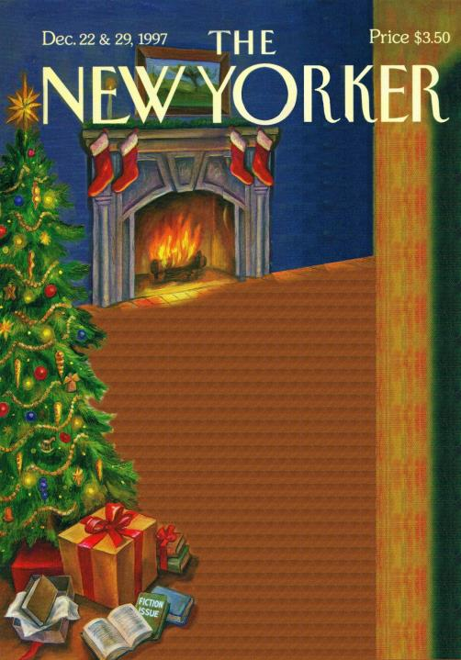
When?

Slide 3
Who?
What is she doing?
Reaction?

Slide 4
Why?

Slide 5
The New Yorker's cover, December 22nd, 1997.
We can see ……………………………………… in ……………………………………………………….……………. Maybe the two characters are ………………………………
……………………………………………………………………….……. In the background, the man …………………….………. ………………………………..…... He is probably …………… .
In the foreground, the woman …..….....................…
…………………………………….the stairs. She looks …………………………………… . She ………………………….... …………………………………………………………………………..
She …………………………..…………..………..so maybe ………………………………………………………………………….

