Slide 1
PLAY WITH « CONTRÔLE PARENTAL » (IT’S ME ! 😁)
Hello guys from the Rift, Here you will learn what you need to know about my 4 champions and how to play around! Have fun my little wolves

Slide 2
Jacques Brell
Rell is an aggressive champion! We have level 2 strong enough, do not hesitate to follow my engages
I Can stun from almost every position As long as I activated the link on you, so the melee champ, i’m talking to you : Stay close to enemies so I Can stun to get close and stun again ! ( CHAIN CC MAGGLE)
If I’m on my mounted form I often Can engage even if i’m low HP due to the Shield gives me W spell ! Trust If I engage
Midlaner, if we are winning botlane I’ll go mobi si you can Ask for a roam !

Slide 3
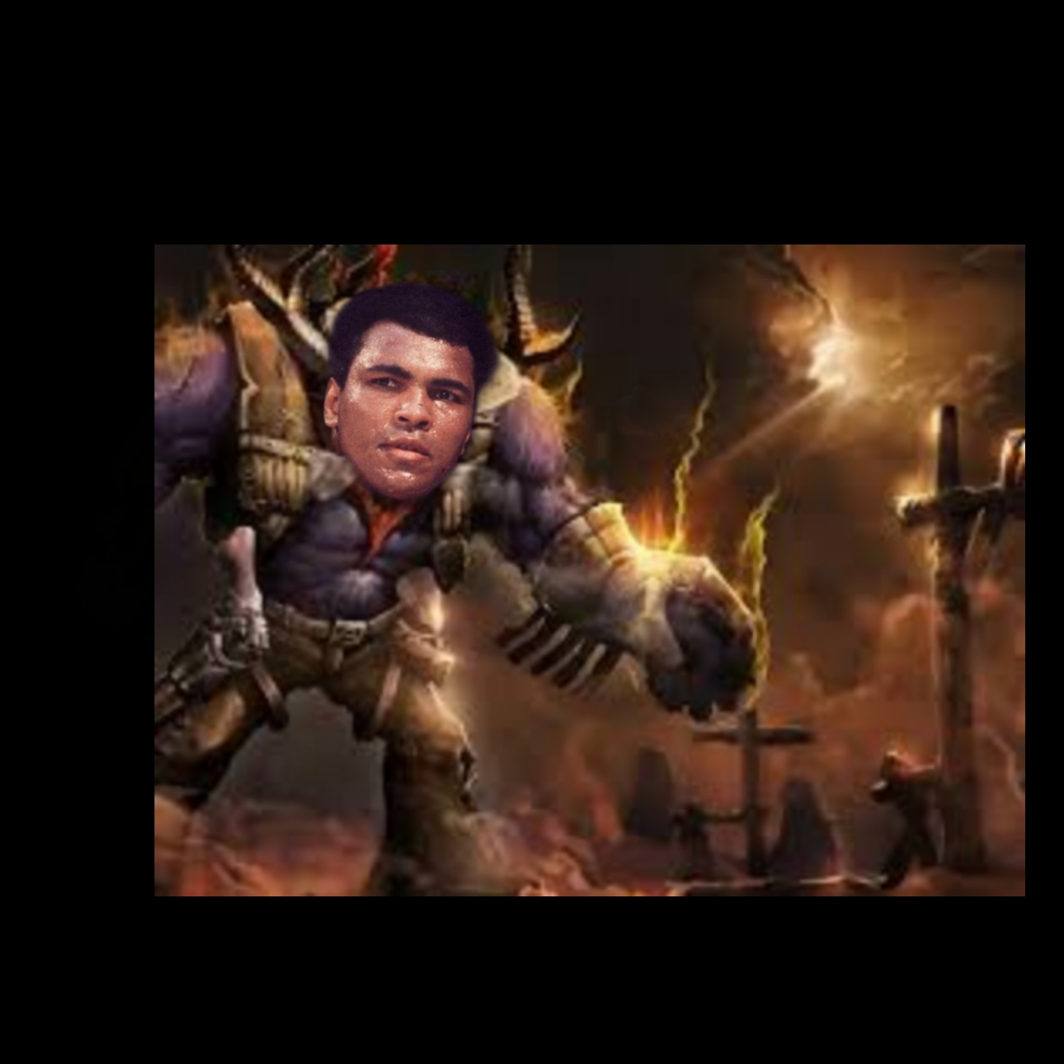
Mohamed Alistar
- Alistar is an aggressive champion! We have level 2 pretty strong, but don’t greed to much or we will get killed
My level 3 gives me ever more stun and i’m playing phase rush : Easy chase while + chain CC
On My R I can’t die : huge teamfight and also we Can dive !
Don’t forget My passive Can heal you, not Much but take creeps when you need little bit of healing
Again if we are winning bot i’ll roam mid !

Slide 4
Maokai Zedong
Again, Maokai Is an aggressive champ with strong level 2, follow the engage !
Thanks to my forest troupe, we can play around the bushes, but I play Tank don’t expect me to spam Poke with them
My combo W+Q throw my ennemy behind me, be carefull to not get caught !
MOBI IF WE ARE WINNING I’M TALKING TO YOU MIDLANE

Slide 5
Gengis Rakan
Pretty agressive too but don’t have as cc as the other, great engage tho
If I touch my Q that will heal you when you are close to me so get close to me when I do
I Can Shield you twice with my E + It helps me to get close so pls If you are low and want survive or if you need engage : Get in my range si I Can Shield+stun
At level 6 I have an insane engage potential so strong teamfights !
I will probably rush mobi and shurelia so prépare for potential roams !

Slide 6
GL HF TEAM
Also dont blame me lmao

