Slide 1
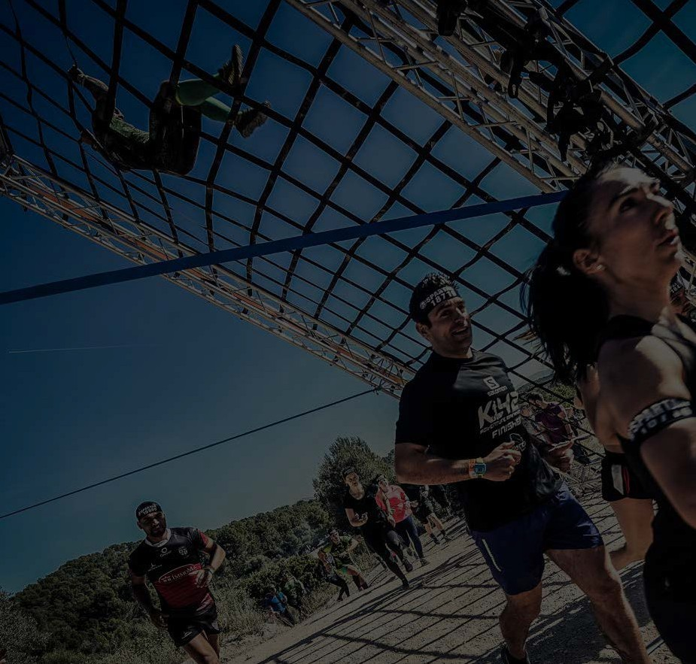
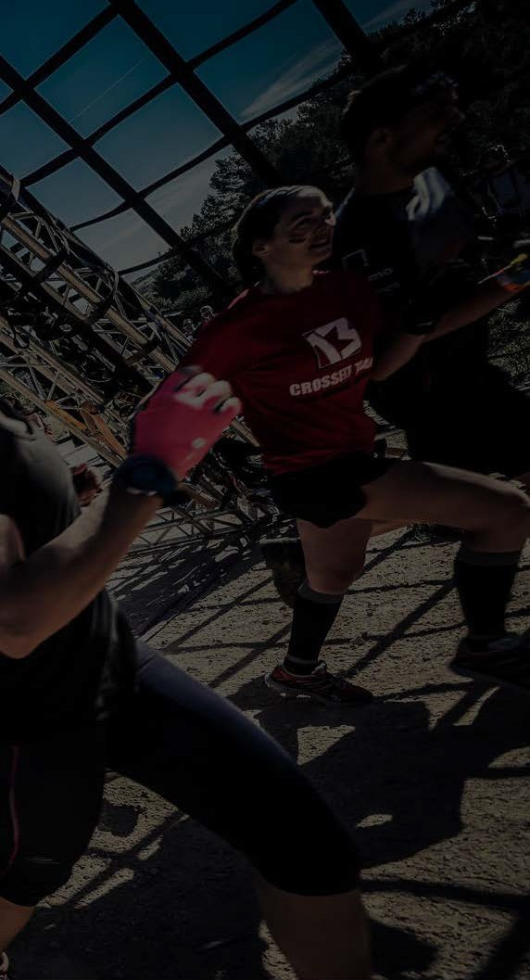
ATHLETE GUIDE
COVID-19 REQUIREMENTS
#SPARTANFRANCE
AUGUST 21-22, 2021

Slide 2
2.HEALTH PASS
MANDATORY
All participants have to present the Health PASS to be able to race in Morzine.
This Health Pass is absolutely MANDATORY, without it, you are not allow to take the start
Dowload TOUSANTICOVID on your phone
PCR or TMA taken no more than 48 hours in advance.
COVID-19 official vaccination certificate.
Antigen test taken on site at the event. No other antigen test will be accepted.
MORE INFORMATION HERE
Some pharmacy will offer the possibility to make a TMA test onsite but keep in mind the number is very limited.
Answer our special form HERE

Slide 3
READ CARREFULLY
Mask Wearing in all areas where sport is not being practiced, that is: all areas within the festival grounds, during registration, at the start and finish of a race, at our merch shop...
At the starting line at the beginning of the race, until participants have naturally grown further apart.
Heat Reduction The sizes of the heat have been reduced and the course has been extended to ensure social distance.
Bag Check for little items ONLY (ID – Phone – Keys)
Adpated aid station: bring our own hydration system (bag or retractable cup)
Spectators : not allowed in close area (registration, bag check, start and finish line) – Allowed on festival area. Heath Pass not required
PROTOCOL

Slide 4
6.COMING TO MORZINE
502 ROUTE DU PALAIS DES SPORTS
74110 MORZINE-AVORIAZ
LOCATION
By car, plane or train, find the access information HERE
You can use all the city parking to park you car, free shuttle will bring you to the Festival area!
Més de

Slide 5
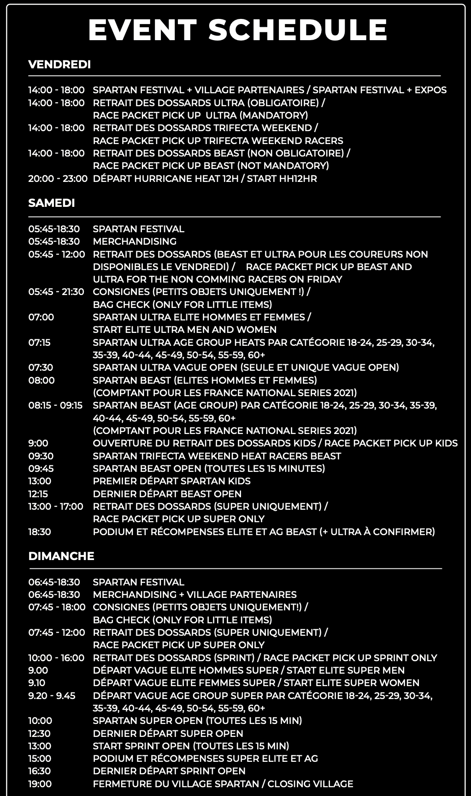
SCHEDULE
Més de

Slide 6
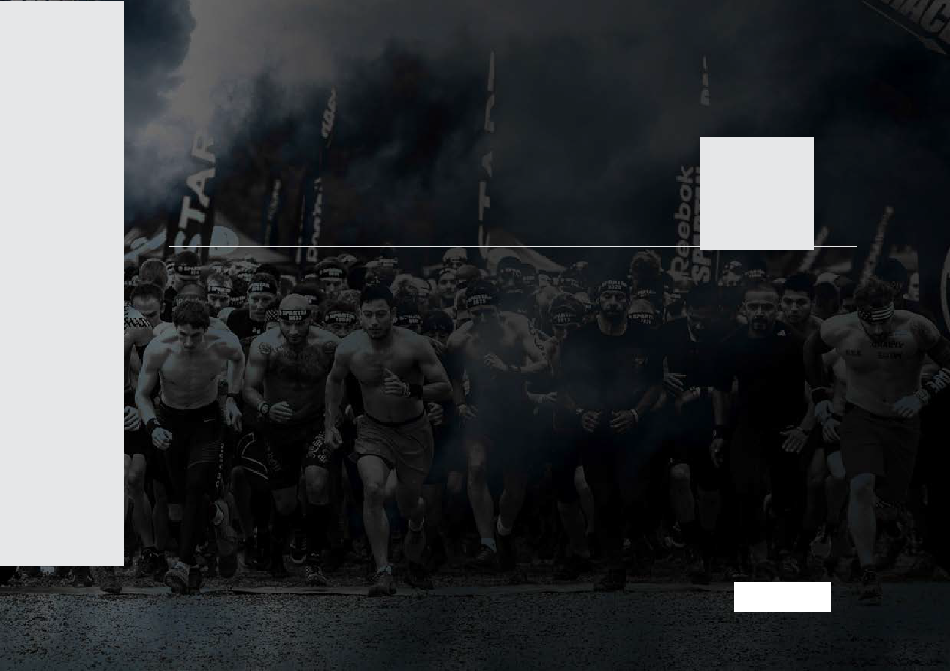
1.
FACEMASK
Don´t forget to bring your own facemask!!!
PRE RACE
2.
BARCODE, ID & COVID DOCUMENT
To pick up your bib number you will need:
A valid ID (with photo)
Your confirmation email either on your phone or printed with the barcode on it for registration. You can also find the barcode in your MaxFun account. how to find the barcode.
Your Medical Certificate (more information HERE)
Your HEALTH PASS (in the APP TOUSANTICOVID)
PICK UP MANDATORY ON FRDAI FOR ULTRA RACER
3.
EAT/HYDRATE
Eat. Hydrate. Eat. Hydrate. It is important to get yourself race ready in the days leading up to your event.
4.
NO SENTIMENTAL ITEMS
We suggest leaving sentimental items at home (rings, jewelry, etc.)

Slide 7
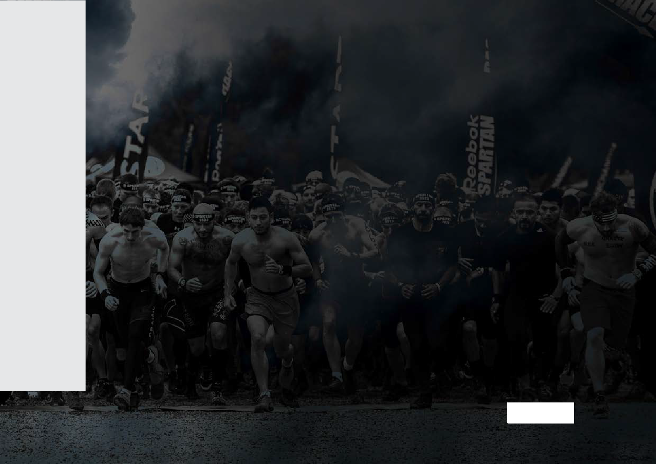
BRING HYDRATION PACK
_{5.} Bring a hydration pack. Don’t forget it in SUPER/BEAST/ULTRA category.
Fill it up before you leave the house. You can never have enough water.
Number of aid stations and products are limited due to COVID-19 restrictions- make
sure to bring a camelbak (that you can refill on the course also).
PRE RACE
6.
GELS AND BARS
Keep your energy up. Specially in the SUPER/BEAST/ULTRA category, gels and bars will give you a boost and help to prevent cramps.
Number of aid stations and products are limited due to COVID-19 restrictions-
make sure to have your nutrition plan.
_{7.} BRING EXTRA CLOTHING
Due to COVID-19 restrictions there will be NO Bagcheck, NO changing and NO
showers on the festival area. Bring some extra clothes to change yourself after your race- and let that into your car.

Slide 8
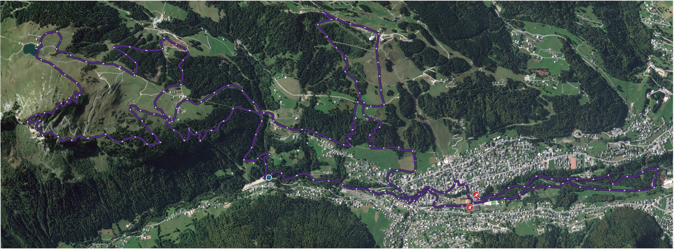
ELEVATION
(CLICK TO ENLARGE)
Més de

Slide 9
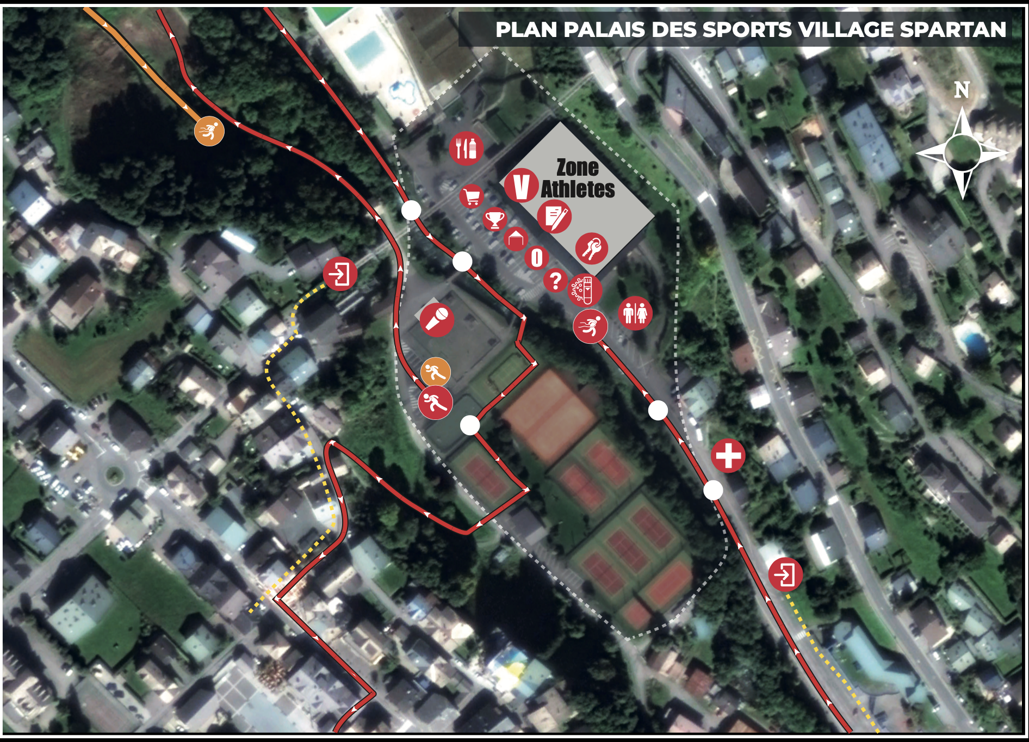
FESTIVAL AREA
(CLICK TO ENLARGE)
Més de

Slide 10
MANDATORY GEAR LIST – CONTROL WILL BE DONE BEFORE, DURING AND AFTER THE RACE.
1 Backpack, running vest, or other device available to carry all mandatory equipment
1 Hydratation system with the ability to carry a minimum of 30 oz (1 liter) of fluids in any type of containers
1 survival blanket or bivvy
1 emergency whistle
1 fashlight or headlamp with backup batteries (waterproof)(you can also find one at the merch tent)
1 red flashing light, to be attached to the back of the pack/vest or headlamp strap and be turned on at all times when when dark, and when instructed to do so by race staff. Solid flowing light and lights of colors other than red are not acceptable OR cyalume glow stick red - at least 12 hours autonomy
GEAR LIST

Slide 11
CUT OFF | LOCATION | CUT OFF* | KM
CUT OFF 1 | VERTICAL NET ULTRA | 07:00 | KM 26
CUT OFF 2 | AID STATION 4 | 09:00 | KM 36
CUT OFF 3 | AID STATION 5 | 11:00 | KM 44
CUT OFF 4 | AID STATION 6 | 12:00 | KM 47
CUT OFF 5 | FINISH LINE | 14:00 | KM 53
CUT OFF
*Effective time of race after the last Start (07:30am). Last Cut OFF will be applied after 14 hours of race so at 9:30pm

Slide 12
Transition area is dedicated to ULTRA racers at– KM 25.
(On the Village Area – front of Palais des Sports)
You can change your clothes, and enjoy a nice aid station
TRANSITION AREA
PICK UP YOU TRANSITION BAG
During your bib pick up on Friday, our Staff will give you a special bag for the transition area
1.
PREPARE YOUR TRANSITION BAG
Prepare your bag with the equipment you will need at the transition area (clothes – aid station…)
2.
LEAVE YOUR BAG AT THE TRANSITION AREA
On Saturday morning, before the Start, leave your bag at the transition area (close to the start), you will find him back during your race !
3.

Slide 13
Environmental rules along the course:
It is forbidden to abandon the path that’s been signalled out by the organisation. Runners that step out of the marked areas, lakes, or rivers that are not par of the circuit will be penalised.
It is forbidden to break, hide, or erase any of the beacons or indication signs in sensitive areas.
It is forbidden to cross rivers or streams outside of the path enabled by the organisation.
It is forbidden to throw any kind of waste or residue into the environment, including personales technical equipment such as backpacks, clothes, food wrappings, etc.
It is absolutely forbidden to start any kind of fire.
Feeding the local fauna is not allowed.
Leaving refreshment stops with the drinking cups is not allowed.
It is forbidden to damage or destroy trees or bushes in wooden areas (such as breaking twigs or branches off of trees).
ETIQUETTE

Slide 14
JOINS US
Consult our FAQs
-Transfert
- Start time
- Equipment
And more…
Need more help ? Contact us

