Slide 1
GROUP
PRESENTATION
2021

Slide 2
AT A GLANCE
GROUP
1992
30 years of experience
22
Factories in Asia
GROUP
6160
Specialized people
682 M$
Turnover

Slide 3
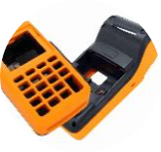
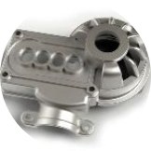
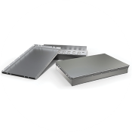
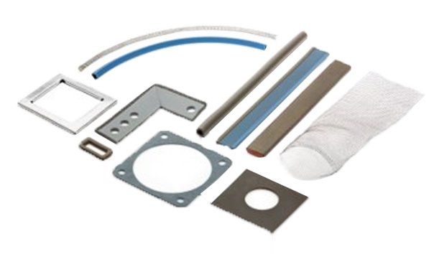
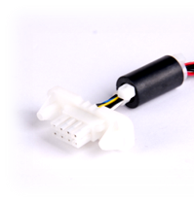
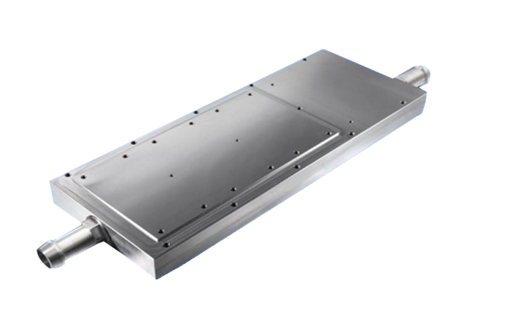
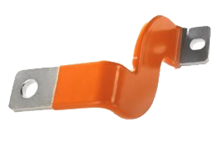
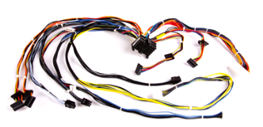
OUR EXPERTISE
GROUP
ALUMINIUM EXTRUSION
PLASTIC INJECTION
CNC MACHINING
TURNING LATHING
DIE CASTING
METAL STAMPING
DIE CUTTING
SURFACE
TREATMENT
EMI
COLD PLATES
BUSBARS
HARNESSES
CONNECTORS

Slide 4
WHAT MAKES US DIFFERENT
GROUP
Manufacturer of mechanical parts on drawings
Simple part, Multi-process & sub-assemblies
One-stop
Mechanical provider
In house tooling design
fabrication
Make your work simple
Co-design, aid
& consultation
Material selection
Process selection
Technical trials
& experiments
Significant time
and cost savings
10 days time-saving
1 MANUFACTURER
from single part
to system-integration
1 WINDOW
for multiple processes

Slide 5
WHY STELIAU TECHNOLOGY
GROUP
ONE EXCLUSIVE
PARTNER
FRANCE
Sales engineers
Product manager
Designers
ASSIGNMENTS
Customer Technical Support
Project Management & NPI
Product & Process Engineering
Qualification
Quality Management
CERTIFICATIONS
& ADVANTAGES
Parts conformity
Process repeatability
Competitive price
Deadline compliance
Certified ISO 9001
CHINA
Engineers
Quality experts
Project Managers
MONITORING
Annual Audit Quality
Prototype & production control
Quality process audit
Shipment Inspection

Slide 6
PROJECT MANAGEMENT
GROUP
4. MASS PRODUCTION
1. DRAWING (2D/3D)
OQC (Outgoing Quality Control)
Shipment monitoring
Periodic quality check
Co-design client
Design qualification
DFM (Design For Manufacturing)
3. TRIAL PRODUCTION
2. PROTOTYPE
First batch full quality check
OQC (Outgoing Quality Control)
PPAP (Production Part Approval Process)
Sample qualification
FAI (First Article Inspection)

Slide 7
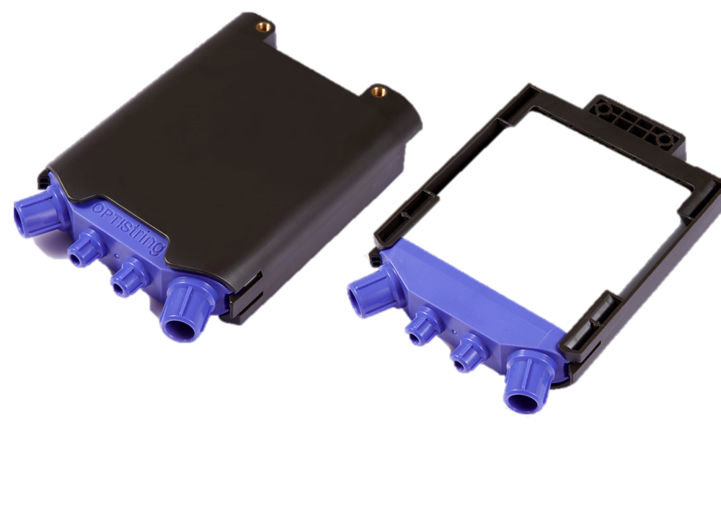
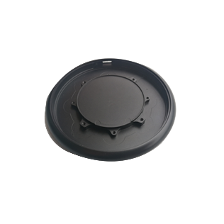
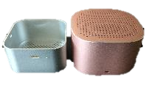
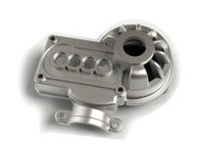
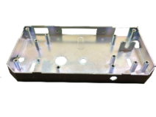
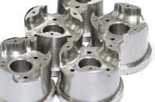
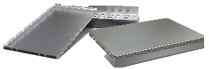
OUR EXPERTISE
GROUP
ALUMINIUM EXTRUSION
PLASTIC INJECTION
CNC MACHINING
DIE CASTING
METAL STAMPING

Slide 8
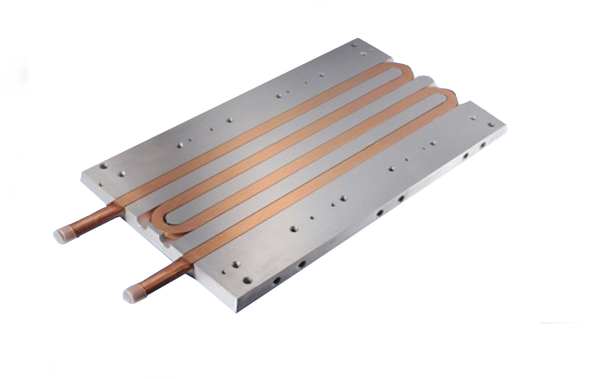
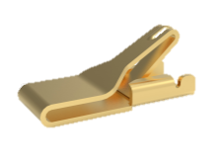
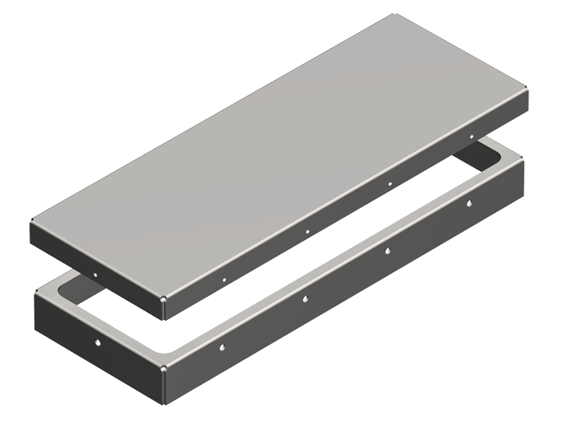
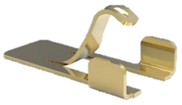
OUR EXPERTISE
GROUP
COLD PLATES
BUSBARS
EMI
SURFACE TREATMENT

Slide 9
QUALITY
GROUP
INDUSTRY SYSTEM
ISO 9001
AUTOMOTIVE
IATF 16949
TRANSPORTATION
IRIS/22163:2017
ROHS
ROHS
ENVIRONMENT
ISO 14001
MEDICAL
ISO 13485

Slide 10
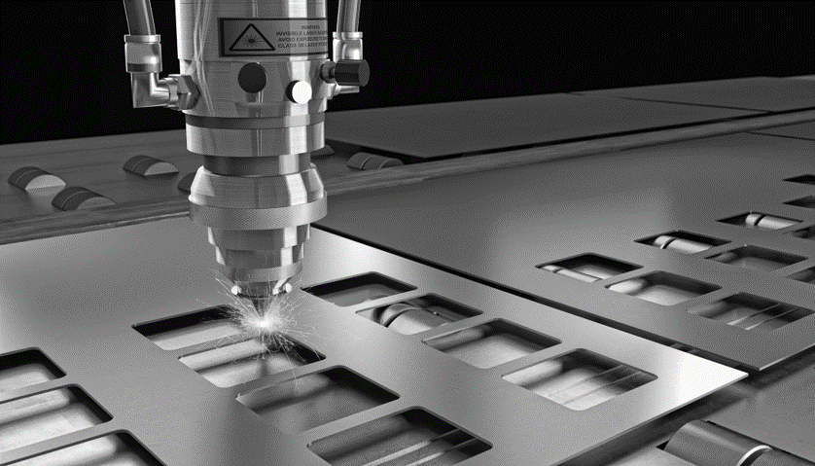
/
/
CONTACT US !
41, rue Périer, 92120, Montrouge, FRANCE
Olivier LEVELT Mechanical Product Manager
Aurélien BERGÉ Mechanical Department Manager
+ 33 (0)6 12 36 39 72
+ 33 (0)6 77 62 51 87

