Slide 1
Source of finance
OBJETIVES
QUESTIONS
GAME

Slide 2
Explain the role of finance for businesses in terms of capital expenditures and revenues expenditures.
Comment on the following internal sources of finance: personal funds, retained profits and sale of assets
RETURN

Slide 3
Questions
1. What do you think businesses need funds for?
2. What is capital expenditures and revenue expenditures?
3. What are the internal sources of finance?
RETURN

Slide 4
All forms of business organization need fundings for the various activities they undertake. The money could be needed for a variety of reasons, including starting a business, for its day to day operations, or for its future growth and expansion. As result, businesses need to ascertain or be clear on the exact purpose of their finance. This purpose can be classified as either capital expenditure or revenue expenditure.
RETURN

Slide 5
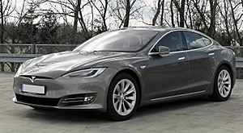
Capital expenditure.
This is money spent to acquire ítems in a business that will last for more than a year and may be used over and over again. Such ítems are known as fixed assets and include machinery, land, buildings, vehicles. These fixed assets are needed for the purpose of generating income for the business over the longer term in order to succeed and grow.

Slide 6
Capital expenditure.

Slide 7
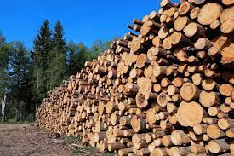
Revenue expenditure.
This is money spent on day to day running of a business. These payments or expenses include rent, wages, raw materials, insurance, and fuel.

Slide 8
Revenue expenditure.

Slide 9
Internal sources of finance.
Internal finance is money obtained from within the business and is usually from already established businesses. Some of these sources include the following.
Personal funds.
Retained profit.
Sales of assets.

Slide 10
Personal funds.
This is the key source of finance for sole trades and it comes mostly from their own personal savings.

Slide 11
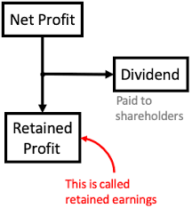
Retained profit.
This is the profit that remains after a business has paid tax to the government and dividends to shareholders. It is also known as ploughed-back profit and may be reinvested into the business, becoming an important source of finance for the organization.

Slide 12
Sales of assets.
This is when a business sells off its unwanted or unused assets to raise funds. These assets that are no longer required by the business include obsolete mahinery or redundant buildings. To raise cash, business could also sell off any excess land or equipment they may not be using.

Slide 14
Did we fulfil our objectives?
Explain the role of finance for businesses in terms of capital expenditures and revenues expenditures.
Comment on the following internal sources of finance: personal funds, retained profits and sale of assets
RETURN
FINISH

